Slide 2
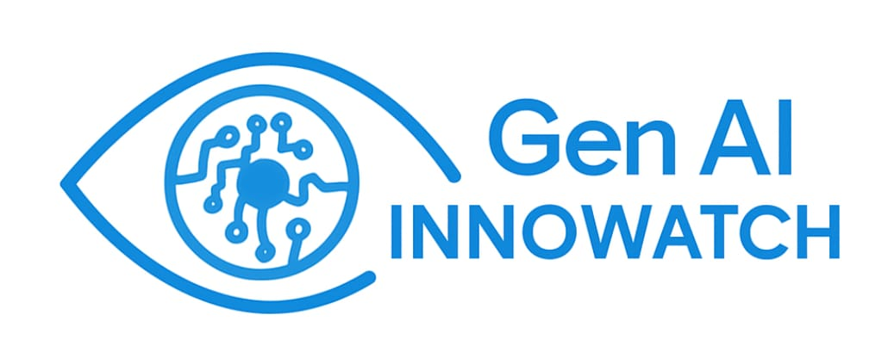
Team Gamma Summary
Introduction:
Team Size | Team Members | Mentors and Coordinators
5 | SPOC :Vishaal Gokul Vishal Vivek Sakthi KrishnaKumar Soma Sekhar Nanimela Anirudh Umesh | Saksham Fotedar Hareesh N Srinivas Palli Annu Gupta Aditya Kandi
We have developed GenAI-powered Infrastructure Health Monitoring System that is designed to provide actionable insights into your existing infrastructure's current status, facilitating proactive maintenance leveraging GenAI.
Week 1 | Week 2 (Development starts) | Week 3 | Week 4 | Week 5 | Week 6
Project Charter​ Architecture and flow design​. High-level and Low-level Design.​ Mock UI​. | Worked on the Data pipeline (Log ingestion).​ Worked on LLM processing and output.​ UI creation. ​ Worked on Alerting system.​ | Created the Backend.​ Linked the backend with the UI.​ Added visualization using Grafana in real-time.​ Worked on integration of ML detection in alerts.​ Worked on Chatbot.​ | Optimized the ML detection.​ Worked on Preventive maintenance. Optimized the LLM.​ Refined the UI.​ | Demo changes implementations | Final Presentations Closure
Notes:
We've developed a GenAI-powered Infrastructure Health Monitoring System. The core purpose of this system is to provide actionable insights into an organization's existing infrastructure status. This facilitates proactive maintenance, leveraging the power of Generative AI to achieve this. Ultimately, our goal is to help prevent issues before they occur and optimize system performance
We are a lean team of five dedicated members. I, Vishaal Gokul, served as the SPOC. The team members include Vishal Vivek, Sakthi Krishnakumar, Soma Sekhar Nanimela, and Anirudh Umesh.
We were incredibly fortunate to have the guidance of an excellent team of mentors and coordinators: Saksham Fotedar, Hareesh N, Srinivas Palli, Annu Gupta, and Aditya Kandi. Their support and insights were invaluable throughout this journey.
Week 1: We kicked off the project by establishing our Project Charter. This involved defining the scope, objectives, and initial plans. We then delved into the Architecture and Flow design, laying out the high-level and low-level structures of our system. Finally, we created a Mock UI to visualize our initial concepts.
Week 2 (Development starts): This is where development truly began. We focused on working on the Data pipeline, specifically Log ingestion, which is crucial for collecting the necessary infrastructure data. We also started working on LLM processing and output, a core component for our GenAI capabilities, and initiated UI creation. A significant part of this week was also dedicated to the Alerting system, ensuring timely notifications for critical events.
Week 3: In Week 3, we made significant progress on the backend, creating the Backend and linking it with the UI. We enhanced our data visualization by adding visualization using Grafana in real-time. We also began integrating ML detection in alerts to improve the accuracy and relevance of our notifications, and started working on the Chatbot for interactive querying.
Week 4: Week 4 was focused on refinement and optimization. We optimized the ML detection further and worked on Preventive maintenance aspects of the system. Crucially, we continued to optimize the LLM to enhance its performance and accuracy. We also dedicated time to refining the UI based on our progress and feedback.
Week 5: In Week 5, we primarily focused on Demo changes and implementations. This involved preparing our system for demonstration, making necessary adjustments, and ensuring everything was running smoothly for a clear and impactful presentation.
Week 6: And finally, Week 6 is dedicated to our Final Presentations and the Closure of this phase of the project. We are excited to share the culmination of our efforts with you.

Slide 3
Problem Statement & Solution
Problem Statement
Solution
Collect and display infrastructure health data from various sources including servers, networks, and applications.
Summarize key metrics (CPU, memory, disk I/O, latency, network congestion) to identify potential issues and suggest remediation strategies.
Centralized Log Collection: Set up a unified system to gather and standardize logs from all sources.
Smart Anomaly Detection: Used AI to spot unusual activity early and warn about possible issues.
Performance Monitoring Dashboard: Built a clear dashboard to track key system metrics like CPU, memory, and latency.
Automated Fix Suggestions: Used past incident data and AI to suggest quick and effective solutions.
Real-Time Alerting: Alerts of different types are forward to both the UI and mail services.
Benefits
90%
Reduction
40%
Reduction
50%
Reduction
30%
Reduction
Mean Time To Resolve(MTTR) ​
Mean Time To Detect(MTTD) ​
Unplanned Downtime
Alert Fatigue
Notes:
Our project tackles a critical challenge in infrastructure management. Currently, IT teams face difficulties in:
Collecting and displaying infrastructure health data from diverse sources, including servers, networks, and various applications. This data is often siloed and difficult to consolidate.
Summarizing key metrics such as CPU usage, memory consumption, disk I/O, network latency, and network congestion. Without clear summarization, it's hard to quickly pinpoint issues and, more importantly, suggest effective remediation strategies. This often leads to reactive, rather than proactive, issue resolution.
To counter these challenges, MetricFlow offers a comprehensive solution built on several key pillars:
Centralized Log Collection: We've set up a unified system to gather and standardize logs from all sources across your infrastructure. This eliminates data silos and provides a single source of truth.
Smart Anomaly Detection: Leveraging AI, our system can spot unusual activity early on. This allows us to warn about possible issues before they escalate into major problems, shifting from reactive to proactive monitoring.
Performance Monitoring Dashboard: We've built a clear and intuitive dashboard specifically designed to track key system metrics like CPU, memory, and latency. This provides an at-a-glance view of your infrastructure's health.
Automated Fix Suggestions: A significant differentiator of our system is its ability to suggest quick and effective solutions. By analyzing past incident data and leveraging AI, MetricFlow can recommend immediate steps to resolve detected issues.
Real-Time Alerting: Our system ensures that alerts of various types are forwarded instantly to both the UI and mail services. This ensures that relevant personnel are notified promptly, no matter where they are.
Benefits:
Now, let's look at the tangible benefits our solution brings, translating directly into operational efficiencies and cost savings:
25-35% Reduction in Mean Time To Resolve (MTTR): By providing faster detection and automated fix suggestions, we significantly cut down the time it takes to resolve issues.
30-50% Reduction in Mean Time To Detect (MTTD): Our smart anomaly detection ensures issues are identified much quicker, often before they impact services.
Up to 50% Reduction in Unplanned Downtime: Early detection and proactive remediation directly lead to a substantial decrease in unexpected system outages.
30% Reduction in Alert Fatigue: By providing smarter, contextual alerts and minimizing false positives, we reduce the overwhelming number of alerts IT teams often face, allowing them to focus on critical issues.
25-35% Reduction in Mean Time To Resolve (MTTR): This reinforces our commitment to not just finding problems quickly, but also solving them efficiently.

Slide 4
Industry Analysis
Tool / Capability | Unified Observability | AI-Powered Root Cause Analysis | AI-Powered Generative Solutioning | Proactive Anomaly & Threat Detection | Integrated Alerting | Customizable UI & Dashboards | Open Architecture &LLM Integration
Datadog | ✅ | ✅ | ⚠️ | ⚠️ | ✅ | ✅ | ⚠️
Dynatrace | ✅ | ✅ | ❌ | ✅ | ✅ | ⚠️ | ⚠️
New Relic | ✅ | ✅ | ❌ | ✅ | ✅ | ✅ | ✅
Splunk | ✅ | ✅ | ❌ | ❌ | ❌ | ✅ | ✅
Elastic Stack | ✅ | ⚠️ | ❌ | ✅ | ✅ | ⚠️ | ⚠️
Grafana Labs | ✅ | ❌ | ❌ | ❌ | ✅ | ✅ | ❌
InnoWatch (Our Solution) | ✅ | ✅ | ✅ | ✅ | ✅ | ✅ | ✅
✅ = Fully supported
⚠️ = Partially supported / limited
❌ = Not supported

Slide 5

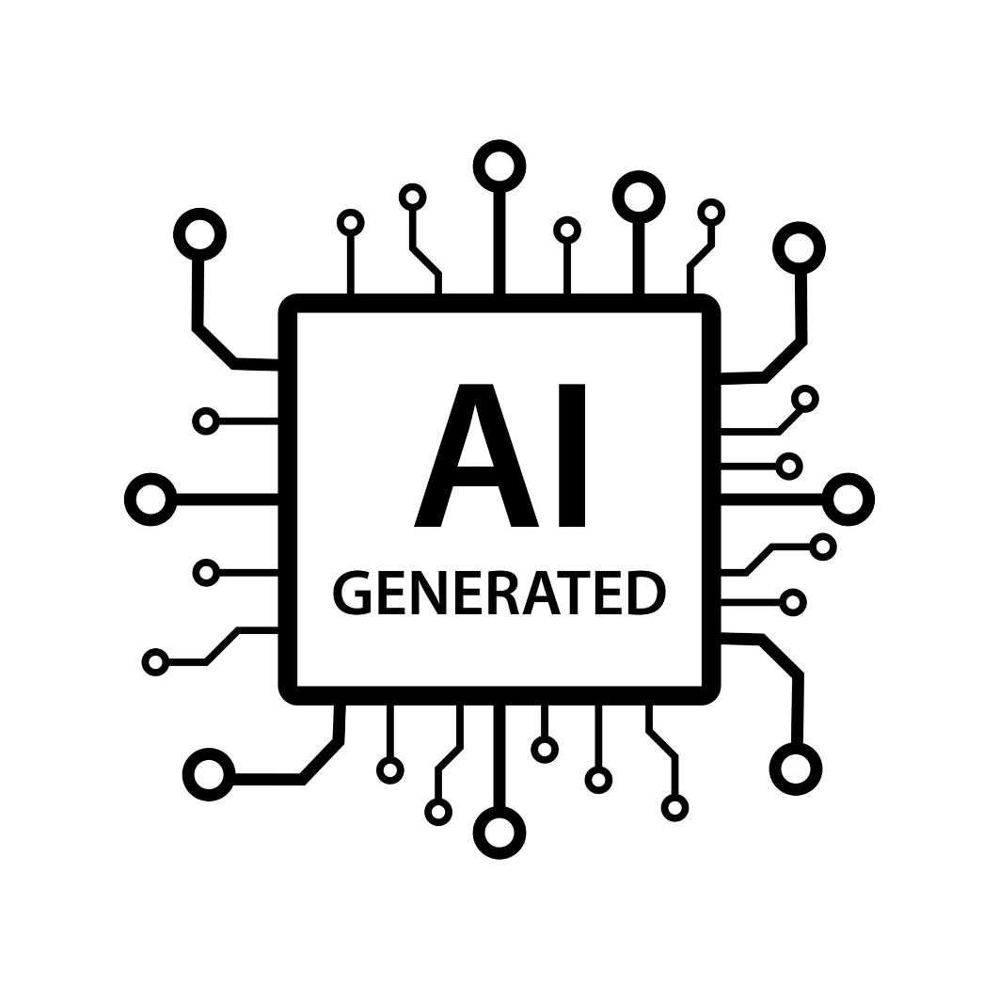
Traditional Approach Vs Gen AI Approach
Error Logs
Manually taken
Researching and finding the root cause of issue
Time-Intensive
Large yet skilled workforce required
Human-Overlook possible
Server Logs
Finding Optimal Solution
App Logs
More workforce
Network Logs
Lesser Workforce
Automated Generation
High Accuracy
Lower Workforce
Lower MTTR
Fixing the Error and Maintaining
Real-Time ingestion and analyzing
Root causes and issues already identified and solutions suggested
Notes:
Today, I'll highlight the stark contrast and benefits of moving from a traditional error management approach to our Gen AI-powered solution.
First, the Traditional Approach (Top Flow):
It starts with manual log ingestion from servers, apps, and networks.
This requires a large workforce to manually research, find root causes, and identify solutions.
The core challenges are: it's time-intensive, requires skilled labor, and is prone to human oversight.
Now, our Gen AI Approach (Bottom Flow):
We utilize real-time log ingestion and AI analysis.
Our AI automatically identifies root causes and suggests solutions. This significantly reduces the need for human intervention and results in a smaller workforce.
The benefits are clear: automated insights, high accuracy, lower workforce requirement, and drastically reduced Mean Time To Resolve (MTTR).
Let's quantify these benefits in our 'Metric Comparison' table:
Time to Root Cause: From 4-8 hours (manual) to under 1 hour (Gen AI) – over 85% faster.
Troubleshooting Workforce: Reduces from 3-5 people per 100 servers to 1-2 people – a 99% cost reduction.
Diagnosis Accuracy: Jumps from 80-90% to over 95% with Gen AI.
Log Analysis Time: Drops from 10-15 hours/week/engineer to under 1-2 hours – over 85% faster cycles.
Finally, the Cost Savings:
Assuming 1000 servers, and considering the difference between manual ($2000-2500/server/year) and Gen AI ($500-1000/server/year) costs...
We project an Estimated Cost Saving of over 1.5 Million Dollars.
This demonstrates that our Gen AI approach isn't just an efficiency gain; it's a significant financial advantage."

Slide 6
Traditional Approach Vs Gen AI Approach
Metric Name | Current (Manual) | With Gen AI | Benefit
Time to Root Cause Identification | 1-2 hours/incident | ~5 min/incident | >90%Faster
Troubleshooting Workforce | High(3-5 per 100 server) | Lower(1-2 per 100 servers) | >99% Effort reduction
Diagnosis Accuracy | 80-90% | 85-95%+ | >10% Accurate
Manual Log Analysis & Aggregation | 10-15 hours/week/engineer | <1 hours/week/engineer | >90% faster cycles
Assuming Managing 100 Dedicated High-Performance Servers
Estimated Cost Saving ~100K-150K$/Year
Data Assumed:-
Traditional: 2000-2500$ /server/year (Infra + labour)
Gen AI : 1000-1500$ /server/ year

Slide 7
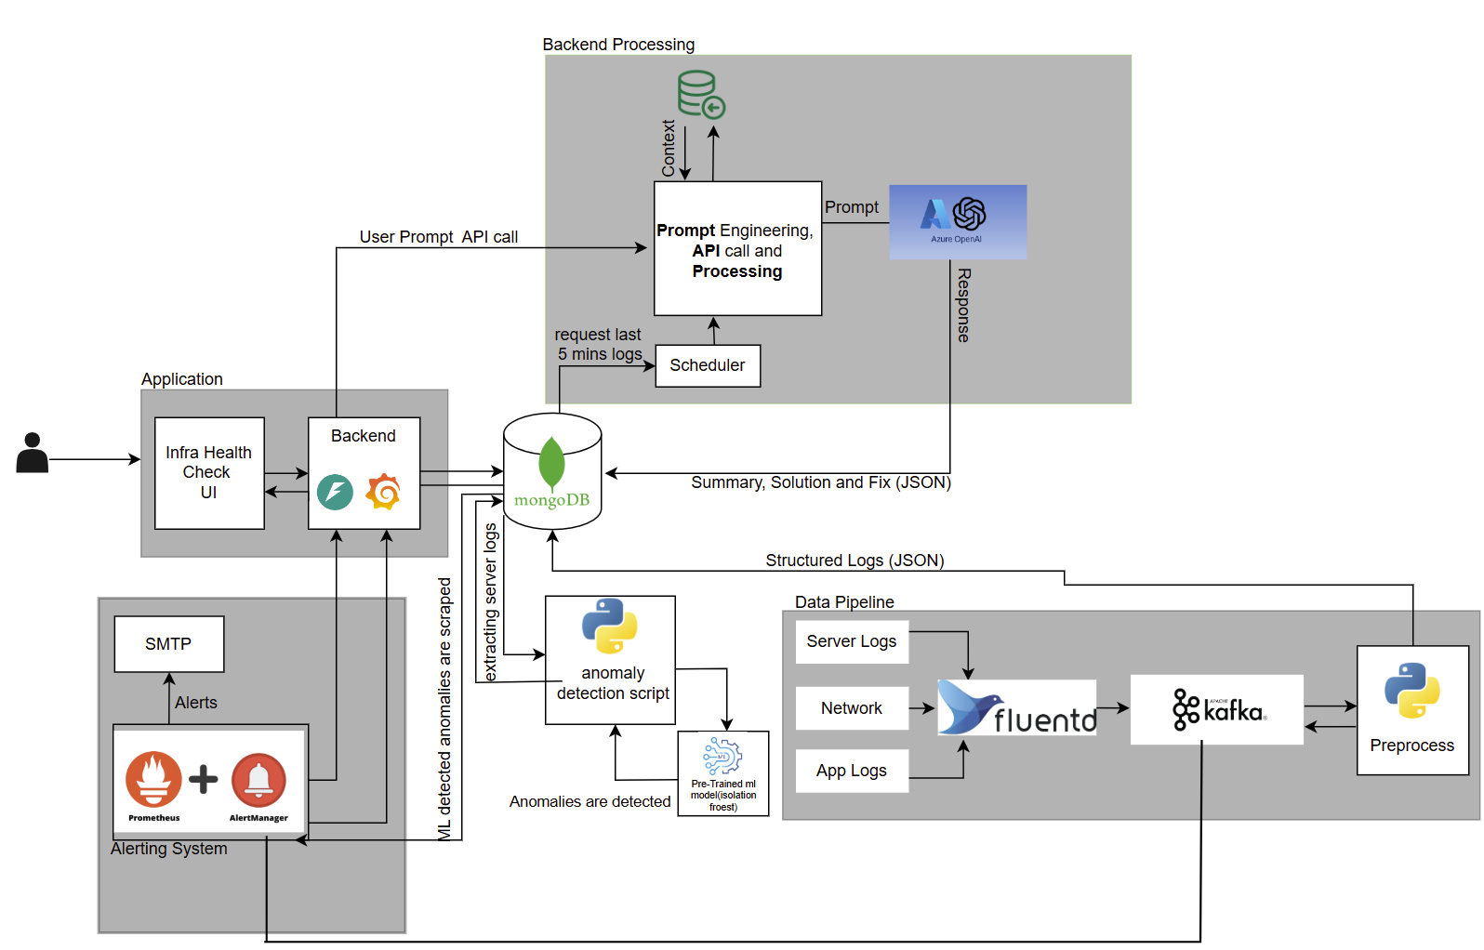
InnoWatch Architecture
Front End & Back End Component:-
UI Dashboard: ReactJS
API: FastAPI
Database:MongoDB
Real-time Visualization: Grafana
LLM Component:-
Root Cause/Solution: LLM (OpenAI)
Préventive Maintenance: LLM assess risks.
Response Storage: LLM outputs to MongoDB.
Data Pipeline:-
Log Collection: Fluentd
Message Queuing: Kafka topics for streaming.
Preprocessing: Logs structured.
Alerting:-
Metrics Alerting: Prometheus
Anomaly Detection: Isolation Forest for anomalies.
Notifications: Alerts to UI and email.
Notes:
Good morning, everyone. Today, I'll be walking you through our proposed architecture for comprehensive log management and intelligent system monitoring.
Our process begins with data collection. We gather network, server, and application logs using Fluentd, which then sends them to various Kafka topics. These logs undergo preprocessing and are then stored in our centralized MongoDB database.
Every five minutes, a scheduler pulls these logs from MongoDB and sends them to our LLM component, Gemini. Gemini analyzes these logs to identify the root cause of any errors and generates solutions. The LLM's responses, including the root causes and solutions, are then stored back into our database.
To make this information accessible, we've developed a UI dashboard using ReactJS for real-time insights and historical data, supported by a FastAPI backend.
Beyond error resolution, we have a robust alerting system. We use Prometheus for metrics-based alerts, such as when CPU utilization exceeds 85%. We also employ an anomaly detection model, specifically Isolation Forest, to detect unusual patterns and potential issues. All these alerts are immediately sent to the UI and via email, ensuring timely notifications.
We also store historical error logs in our database for long-term analysis. Furthermore, we collect server logs and feed them to our LLM to identify potential risks, enabling proactive, preventive maintenance.
For security, we've integrated DDoS attack detection within our network log analysis. And for comprehensive real-time visualization of all our metrics and logs, we leverage Grafana.
This architecture provides an intelligent, proactive, and comprehensive approach to managing our IT infrastructure, ensuring high availability, rapid problem resolution, and enhanced security.

Slide 8
InnoWatch Tech Stack
Tech Stack | Version | Open Source?
Python | 3.13.1 | Yes
React JS | 19.1.0 | Yes
MongoDB | MongoDB Atlas | Yes
Grafana | 11.6 | Yes
Prometheus | 3.4.1 | Yes
LLM (Azure Open AI) | GPT-4-mini | No. Licensed
FastAPI | 0.115.13 | Yes
Kafka | 3.8.0 | Yes
fluentd | 5.2.0 | Yes
Notes:
For our core programming, we're utilizing Python version 3.13.1, which is open source. The front-end user interface is built with React JS, version 19.1.0, also open source, ensuring a dynamic and responsive user experience. Our database solution is MongoDB, version 8.0, which is an open-source NoSQL database known for its flexibility. For powerful data visualization and dashboards, we're integrated with Grafana, version 11.6, an open-source analytics and monitoring solution. Prometheus, version 3.4.1, is our choice for monitoring and alerting, providing robust metrics collection. It's also open source. For the core of our AI capabilities, we're leveraging LLM (Azure Open AI), specifically GPT-4-mini. This is a licensed component, providing state-of-the-art language model intelligence. Our API framework is built with FastAPI, version 0.115.13, an open-source, high-performance web framework. For reliable data streaming, we're using Kafka, which is open source
And for efficient log collection and forwarding, we use Fluentd, which is also an open-source solution.

Slide 9
LLM Evaluation - Quality
LLM Evaluation
LLM Evaluation is the process of assessing the performance of a Large Language Model (LLM) to determine how well it understands prompts & generates responses. Different metrics like cosine, semantic similarity for LLM response.
Metrics | Scores
TF-IDF (Cosine) Similarity | 90.58%
Token F1 | 90.91%
Rouge | 91.89%
BLEU | 89.47%

Slide 10
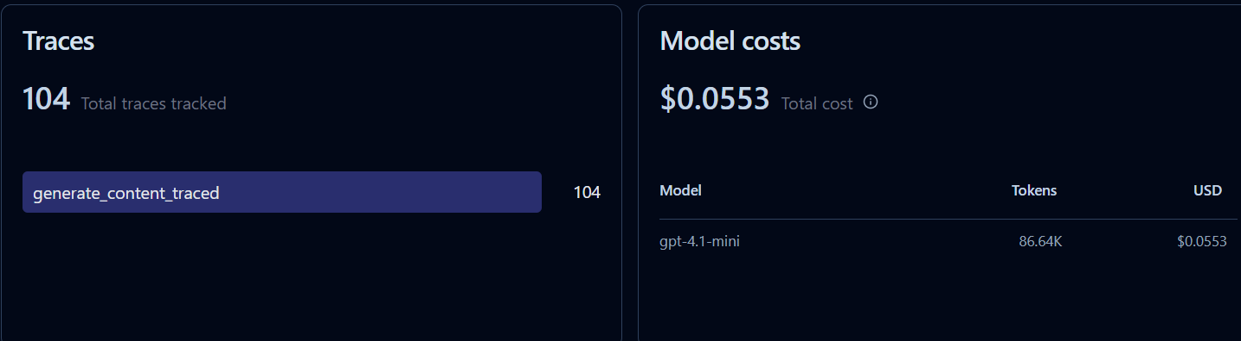
LLM Ops - Monitoring & Observability
Langfuse
Langfuse is an open-source platform designed to help teams monitor, debug, and improve AI and LLM(Large Language Model) applications
https://cloud.langfuse.com/project/cmc8uetno01q3ad07rxqzzefi?dateRange=7+days
Notes:
104 traces tracked we have generated 86.64k tokens and used the

Slide 11
Demo

Slide 12
Potential Feature Enhancements
Enabling Advanced Scaling
Data Security (Encryption)
Enabling Third-Party Integrations
Cost Optimization Module
Implementing Specialized databases and data Tiering
Feedback Loop For LLM
Security Operations (SecOps) & Compliance Integration
Notes:
I'm Anirudh Umesh, and I'll be discussing the exciting future of MetricFlow – our potential feature enhancements. While our current system is robust, we've identified several key areas for future development that will further enhance its capabilities and value.
Let's walk through these potential enhancements:
Enabling Advanced Scaling: Our first area of focus is to implement more advanced scaling mechanisms. This will ensure MetricFlow can effortlessly handle even larger data volumes and user loads as organizations grow, maintaining peak performance under all conditions.
Data Security (Encryption): Data security is paramount. A crucial enhancement will be to implement comprehensive encryption for all data within MetricFlow, both in transit and at rest. This will provide an even higher level of protection for sensitive infrastructure health data.
Implementing Specialized Databases and Data Tiering: To optimize performance and cost, we plan to explore and implement specialized databases for different data types and introduce data tiering. This means storing data in the most appropriate and cost-effective storage solutions based on its access frequency and importance.
Cost Optimization Module: We intend to develop a dedicated Cost Optimization Module. This module will provide insights and recommendations to users on how to reduce their infrastructure monitoring costs, leveraging our GenAI insights to identify inefficiencies.
Feedback Loop For LLM: A vital enhancement for our GenAI capabilities is to build a robust feedback loop for our Large Language Model. This will allow the LLM to continuously learn and improve from user interactions and actual incident resolutions, making its suggestions and analyses even more accurate and effective over time.
Enabling Third-Party Integrations: Finally, we plan to broaden MetricFlow's ecosystem by enabling more comprehensive third-party integrations. This will allow seamless connectivity with a wider range of existing IT tools, ticketing systems, and other platforms, making MetricFlow an even more integral part of an organization's IT operations.

Slide 13
Project Key Learnings
Challenges Faced:
Linking the alerts to the UI in real time.
Grafana Visualization Compatibility Issues.
Reducing the number of tokens used.
Parsing the App logs.
Key Learnings:
Learnt Professional Implementation of GenAI in Projects.
Learnt Software Engineering practices to build solid projects from the Architecture to the Implementation.
Explored and Learned about various tools like Prometheus , Kafka, Fluentd etc.
Valuable Inputs from mentors and working in a corporate environment.
Positives Achieved :
Learned LLM evaluation and various accuracy parameters ,RAG Process ,PromQL queries and YAML scripts.
Developed friendly and lasting relationship with most of the interns and mentors.
Tackling Problems better:- Learnt the root causes of our problems and upskilled ourselves to solve it effectively

Slide 14

Q&A Session:
Open the floor for questions
Address any queries or feedback

Slide 15

THANK YOU!

